Slide 1






Reducing Flight Delays at Southwest Airlines: A Data-Driven Strategy
Meet the Team: Group 4
Ayushi Goel
Licheng Zhong
Louis Wu
Sammy Cayo
Target Audience - Senior Leadership at Southwest Airlines & Co.
Notes:
Sammy -
Mention the target audience as the senior leadership of Southwest and then proceed to introduce the team and the project

Slide 2
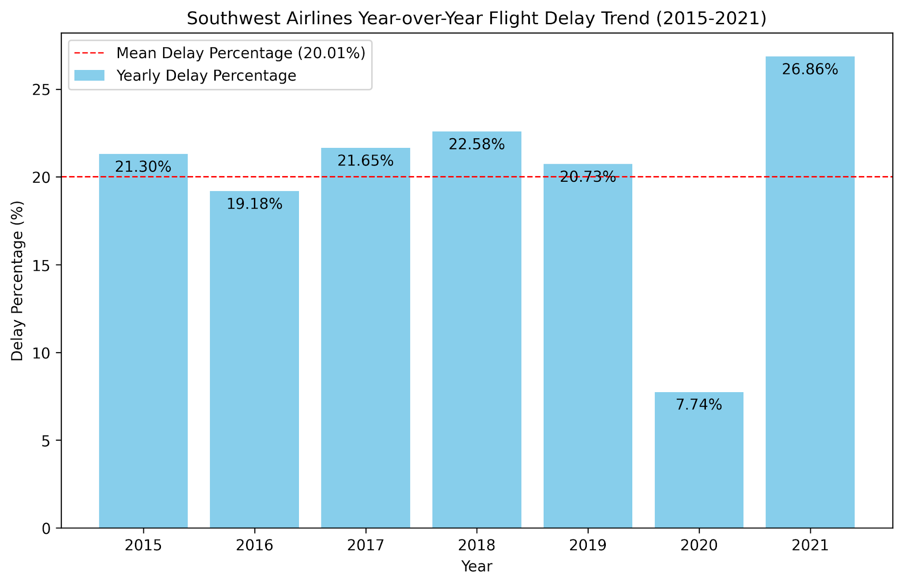
Problem Statement
From 2014-2021, Southwest Operated 14.94 million flights
3.09 million were delayed
20.01% delay rate
7.74% in 2020 attributed to global pandemic
Financial Impact of at least $2.85 Billion
Operational breakdown
Increased fuel consumption (23.5%)¹
Labor cost (55.0%)¹
Maintenance costs (8.4%)²
Cancelled flights compensation payout
Source - See Appendix
Notes:
Sammy -
Why are we proposing this solution
During that span, they operated over 14 million flights and over 3 million of those flights were delayed
This is about 20% of all their flights, with the only exception being 7.7% in 2020, during the global financial crisis
We think this is a major problem
This leads to increase fuel consumption which accounted for 23.5% of Southwest’s operating cost for the year 2021
Southwest’s labor cost were 52.9% of their operating expense
Delays increases the labor cost with higher crew overtime
Higher maintenance cost
Maintenance cost accounts for 8.4% across the industry
and compensation payouts for delayed flights that become cancellations
Sources:
1: https://www.sec.gov/ix?doc=/Archives/edgar/data/0000092380/000009238022000007/luv-20211231.htm
2: https://www.iata.org/en/publications/newsletters/iata-knowledge-hub/unveiling-the-biggest-airline-costs

Slide 3
Objective
Outcome
Machine learning-based prediction to decrease delays
Classification-based models
Logistic regression
Random Forester
XGBoost
Multi-layer Perceptron (Neural Network)
Goal: 5% delay reduction
$142 Million operational cost savings
154,696 fewer delays
↑ Customer satisfaction
↑ Shareholders value
Actual Delay vs Model Prediction
551,740 total delays in 2019
236,912 true delay prediction (True Positive)
~42% of all delays
36,612 not delayed (False Positive)
Cost savings for 2019
~ $218 Million opportunity to reduce cost (see Appendix)
Not all delays can be avoided
5-10% cost reduction target
~$10.9 - $21.8 million for 2019
Image Source - https://career-advising.ndsu.edu/blog/2023/01/13/how-to-set-better-goals/
Notes:
Sammy -
What we do finally want to get out of this 4 week research that we have planned on doing, what will be the advantages of this and financial how important will this decision be for us ( remember presenting to the leadership they only care about the financial numbers)
Here we present our goals for this project
We aim to provide a production-ready Machine learning base model to reduce flght delays, and work with the operations team for deployment
If successfully implemented, we are confident we can achieve a 5% reduction in delays
This will lead to $142 million in operational cost savings
Over 150k fewer delays
higher customer satisfaction
and increase shareholder values by directly affecting our profitability

Slide 4

Image Source - https://openai.com/index/dall-e-3/
Notes:
Sammy -
Quickly mention that in this presentation we will talk about the data used and highlight patterns discovered in it - presented by Ayushi and
Then we talk about the modelling strategy chosen by the team presented by Licheng
And finally we move to our results from this research and the next steps we plan on taking presented by Louis
Here is an outline of our presentation, to start we will provide an overview of the data along with our EDA insights
our Modeling approach for this project
results and evaluation through experimentation
and then the next steps before providing a fully production ready pipeline for deployment
Now I pass it on to Ayushi

Slide 5
Join Pipeline (2015-2021)
airport_codes_csv
Total Time: 19 minutes
Total File Size: 6.6 GB
Deduplicated airlines data from 2015-2019
Performed cross join first, which minimizes number of records created in intermediate CTEs
Performed final range join directly in spark DF, outside of SQL
Bucketed weather and flight times by hour to minimize number of comparisons required
Cross Join
Compute Haversine distance
Evaluate minimum distance over partition by airport code
stations_with_neighbors
parquet_airlines_data
Compute time zone using state
Compute 2 and 4 hours before scheduled departure in UTC
parquet_weather_data
Left Join on Station and Weather Time
Left Join on origin and dest
df_joined_full
Notes:
Louis
At the moment nothing apart from getting data in the format that we anyway want for any basic ml model to work lol, just talk about getting it through the MLlib pipeline, encoding of categorical values and standardization of the numeric ones.
Describe the train/validation/test split
Need to talk about the various types of imputations that were done

Slide 6
Aircraft Tail Number Features
Prev Cancelled: whether the previous flight leg for a given tail number was cancelled
Prev Origin: the origin of the previous flight leg a given tail number
Minutes between Flights: difference between arrival datetime UTC of the previous leg and the scheduled departure time UTC of the current leg
Prev Arr Delay: difference in minutes between scheduled departure time and actual departure time
Prev Arr Delay New: non-negative difference in minutes between scheduled departure time and actual departure time
Prev Arr Delay 15: Whether the delay of the previous flight exceeded 15 minutes
Triplet: a string denoting the origin of the previous leg, the current origin, and the destination of a given tail number

Slide 7


Incorporating Recent Data (2022-2024)
Airlines Data (7.3 GB)
Downloaded by month as .csv files
Uploaded to DBFS through browser
Checkpointed as parquet file
21 million additional rows
Weather Data (11 GB)
Downloaded by year as .tar.gz files
Uploaded to DBFS through CLI
Copied from DBFS to local driver
Extracted on local driver
Copied extracted files to DBFS
Checkpointed as parquet file

Slide 8
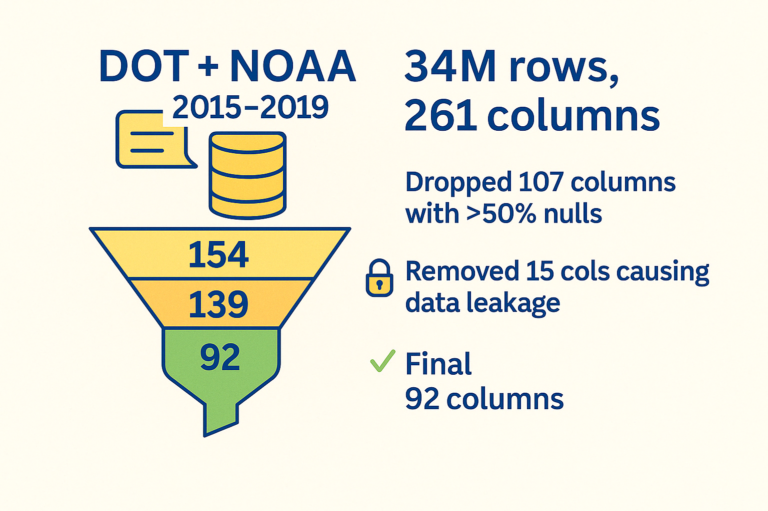
Data Description
Image Source - https://openai.com/index/dall-e-3/
Notes:
Ayushi -
one year data—2015
flight-level records from the U.S. Department of Transportation, and hourly weather data from NOAA.
started with 5.8 million rows and 216 columns
filtered that down to 1.26 million rows
curated set of 26 features
Licheng will talk more about how we handled all the missing values

Slide 9
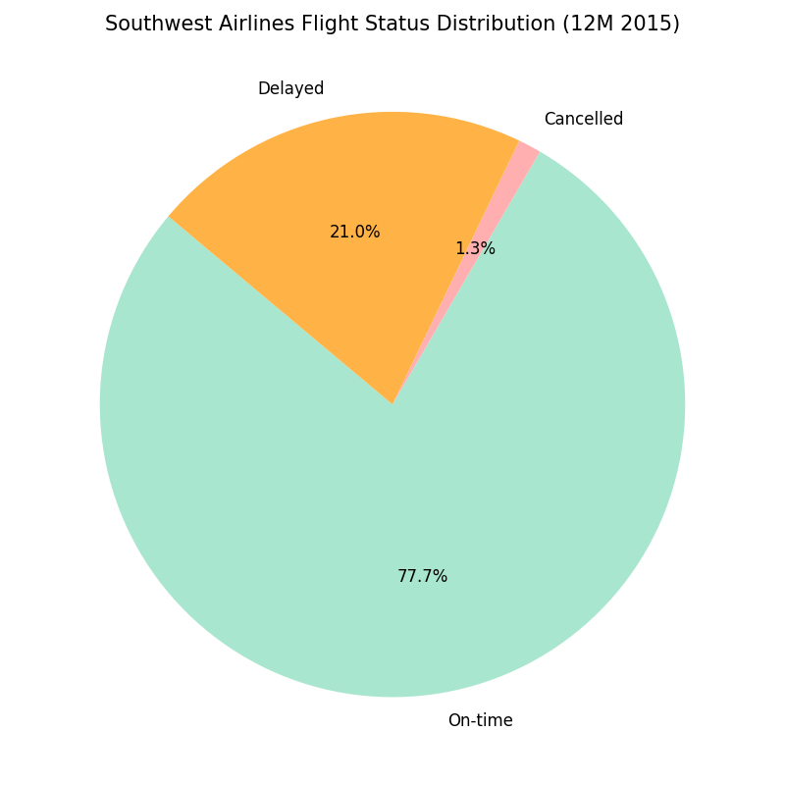
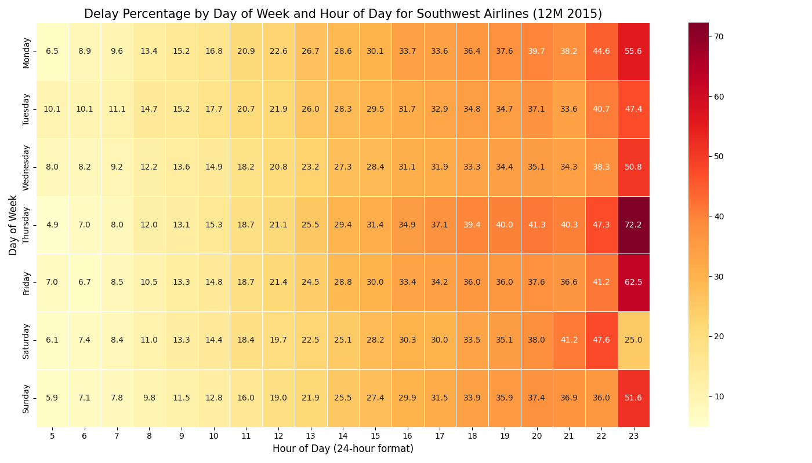
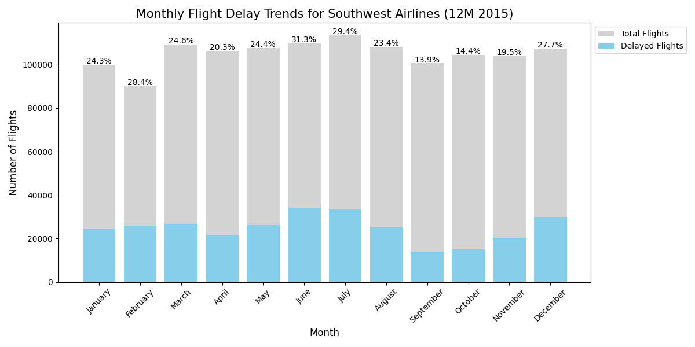
Timing is Everything
Notes:
Ayushi -
Our dataset is heavily imbalanced
Delays ramp up sharply during the summer and winter holiday months
Delays increase later in the day
Mondays and Fridays show consistently higher delay rates

Slide 10
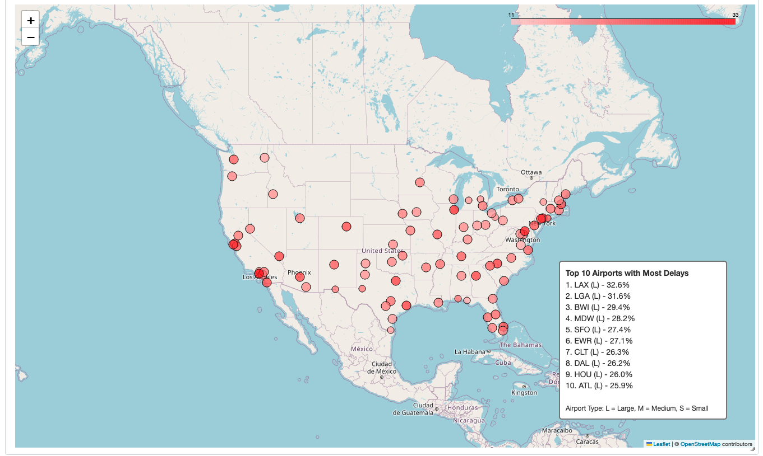
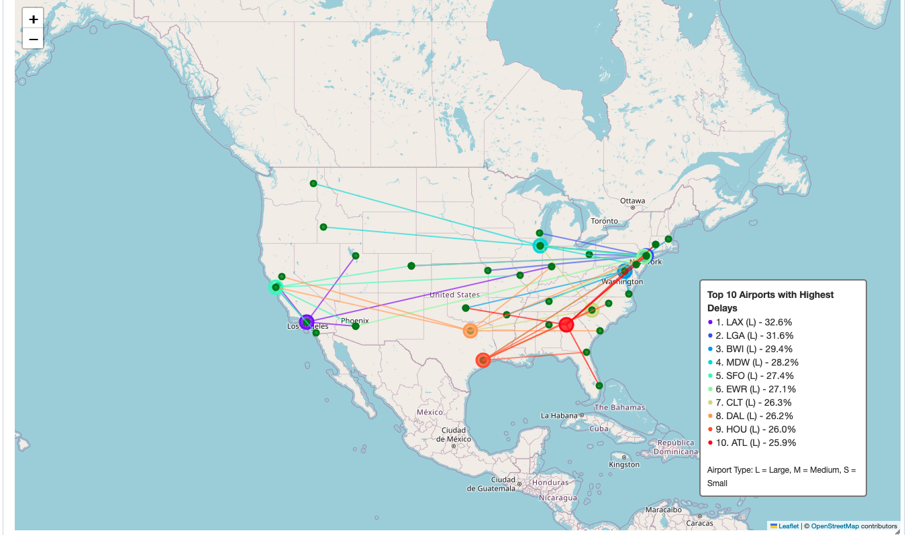
Where Things Are Taking Off... Late
(12M 2015)
(12M 2015)
Notes:
Ayushi -
This map highlights the top 10 airports with the highest delay rates.
Some major players jump right out—Los Angeles (LAX), New York (LGA), and Baltimore (BWI)
Chicago Midway to Boise (MDW → BOI)—nearly 49% of those flights are delayed
Dallas Love Field to Charleston (DAL → CHS) at over 45%.
And Baltimore to Oklahoma City hitting 40%.

Slide 11
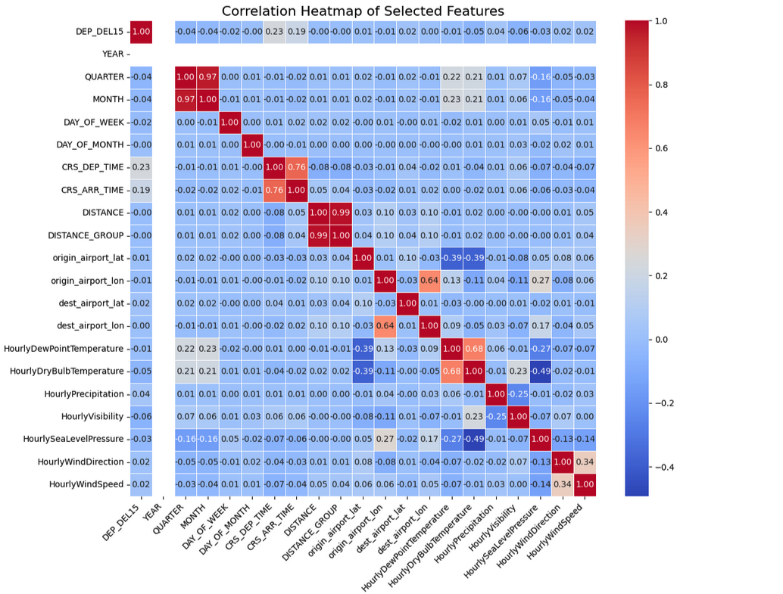
What (Barely) Correlates with Delays - Pearson correlation
Notes:
Ayushi -
Not much actually correlates strongly with delay probability
we’ll need to go beyond raw correlation.
Interactions between features, more granular categorical signals, or even real-time operational data

Slide 12
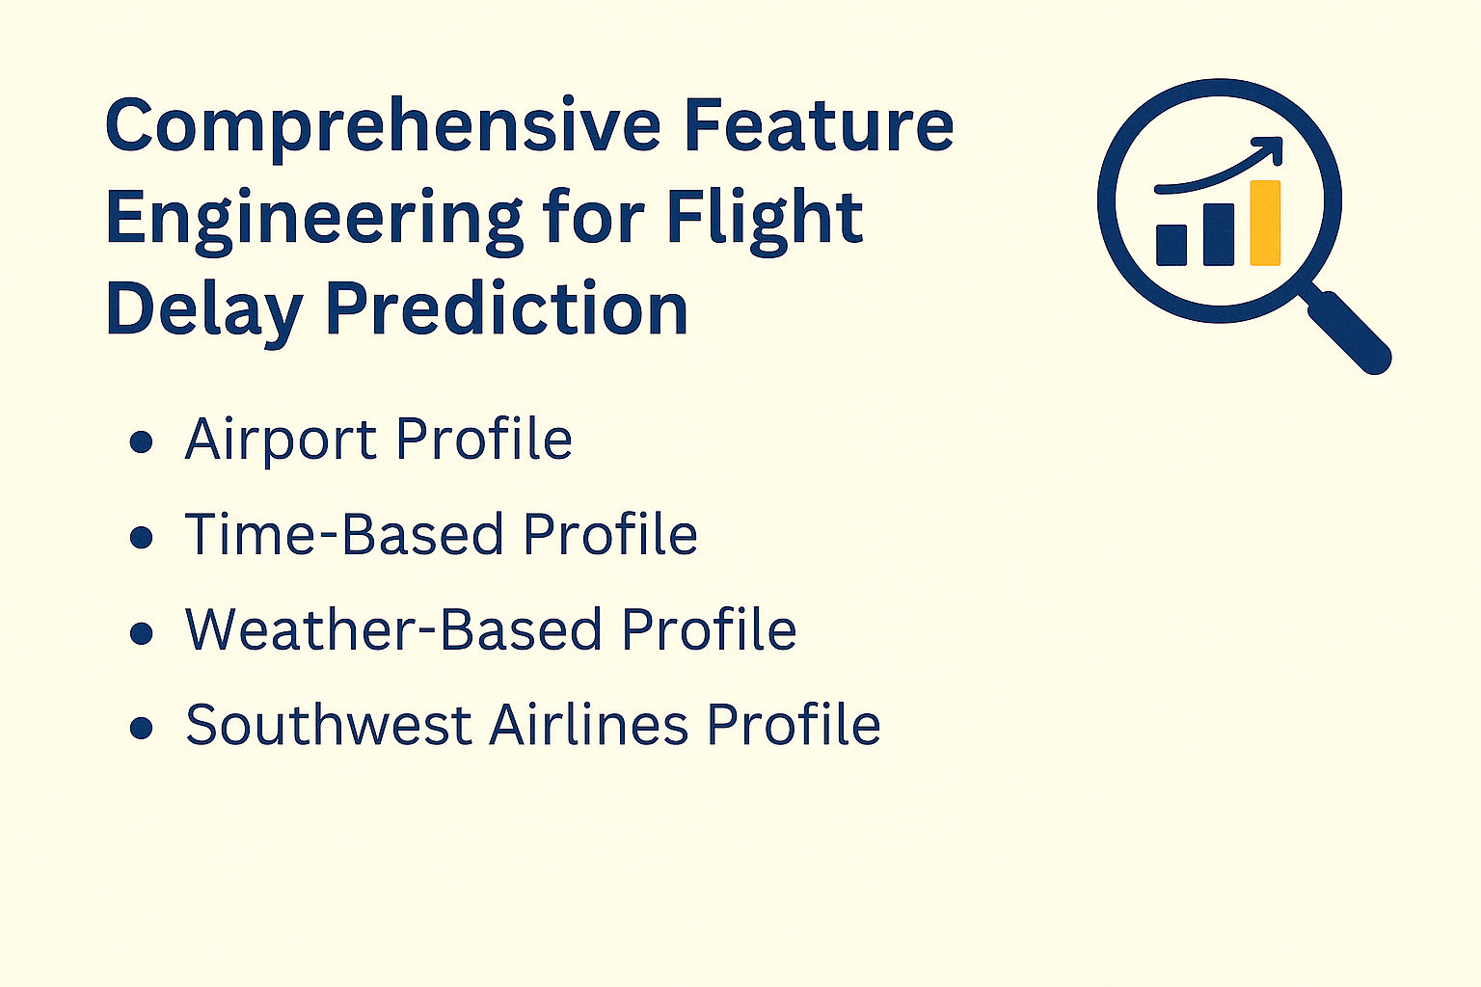
Image Source - https://openai.com/index/dall-e-3/
Notes:
Ayushi -
how skewed is the balance between on-time and delayed flights
seasonal trends
airports giving us the most trouble
how all these features correlate
distance plays into delays

Slide 13
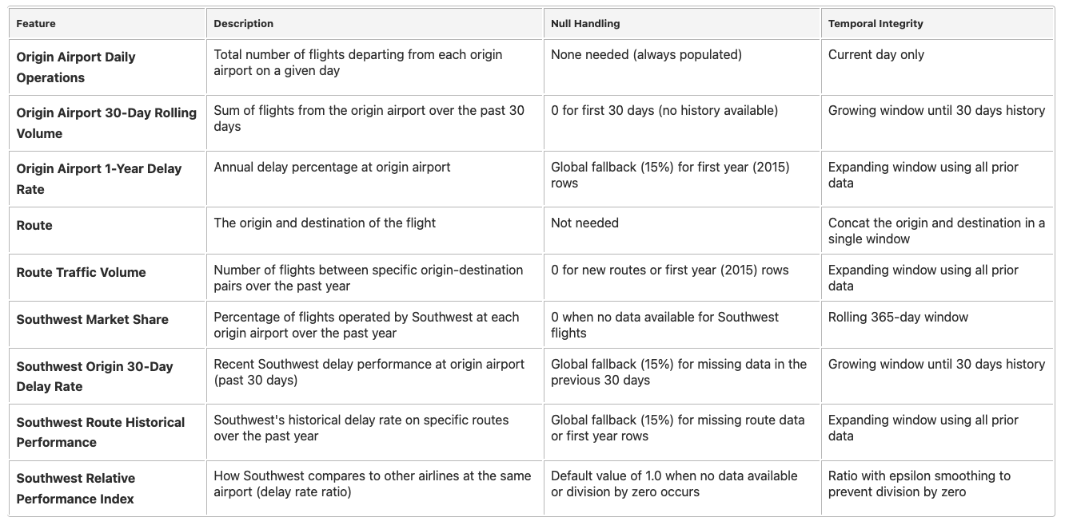
Airport Profile Features
Notes:
Ayushi -
Not much actually correlates strongly with delay probability
we’ll need to go beyond raw correlation.
Interactions between features, more granular categorical signals, or even real-time operational data

Slide 14
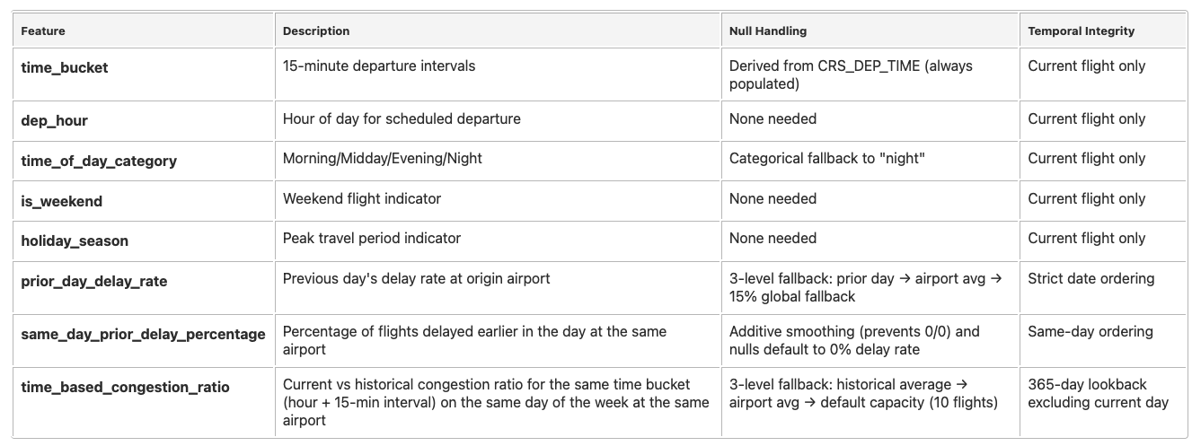
Time-Based Profile Features
Notes:
Ayushi -
Not much actually correlates strongly with delay probability
we’ll need to go beyond raw correlation.
Interactions between features, more granular categorical signals, or even real-time operational data

Slide 15
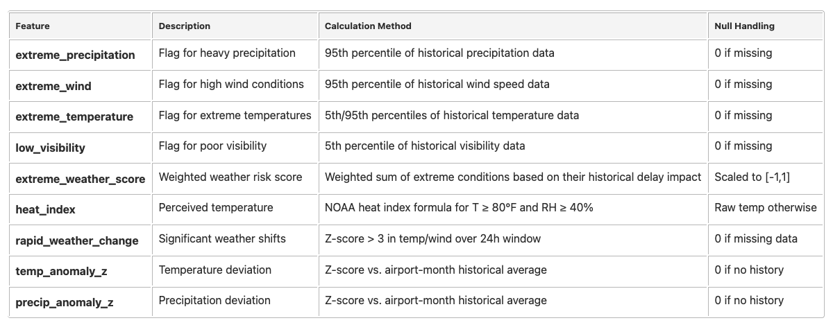
Weather Profile Features
Notes:
Ayushi -
Not much actually correlates strongly with delay probability
we’ll need to go beyond raw correlation.
Interactions between features, more granular categorical signals, or even real-time operational data

Slide 16
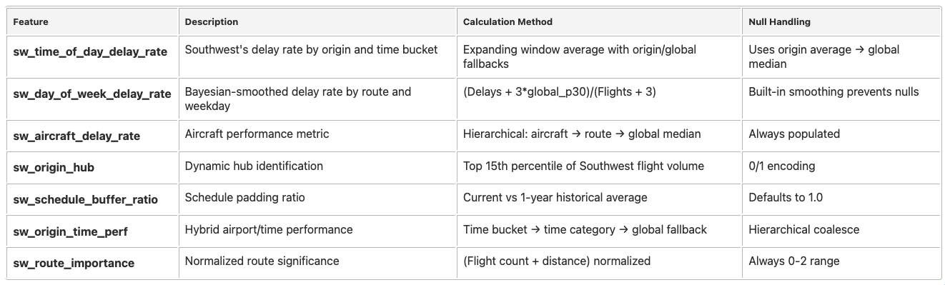
Southwest Airlines Profile Features
Notes:
Ayushi -
Not much actually correlates strongly with delay probability
we’ll need to go beyond raw correlation.
Interactions between features, more granular categorical signals, or even real-time operational data

Slide 17
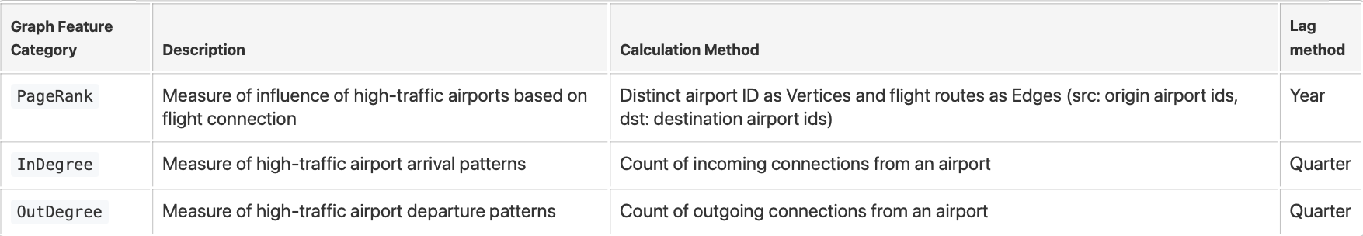

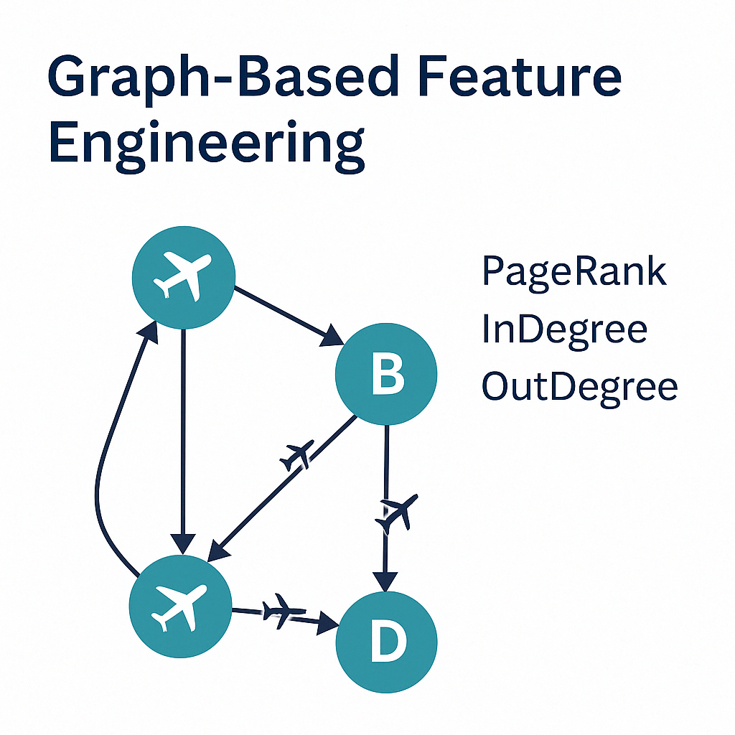
Feature Engineering Graph Based
PageRank
Airport linked to other airports are ranked higher
InDegree
Popular destination have higher values
OutDegree
Major Hubs have higher values
Image Source - https://openai.com/index/dall-e-3/
Notes:
Sammy
PageRank
Measure the influence of high traffic Airport based on flight connections
Vertices: Unique Airport IDs
Edges: flight route
Src: Origin airport id
Dst: Destination airport id
InDegree
Quarterly counts of incoming connection from an airport
OutDegree
Quarterly count of outgoing connection from an airport

Slide 18
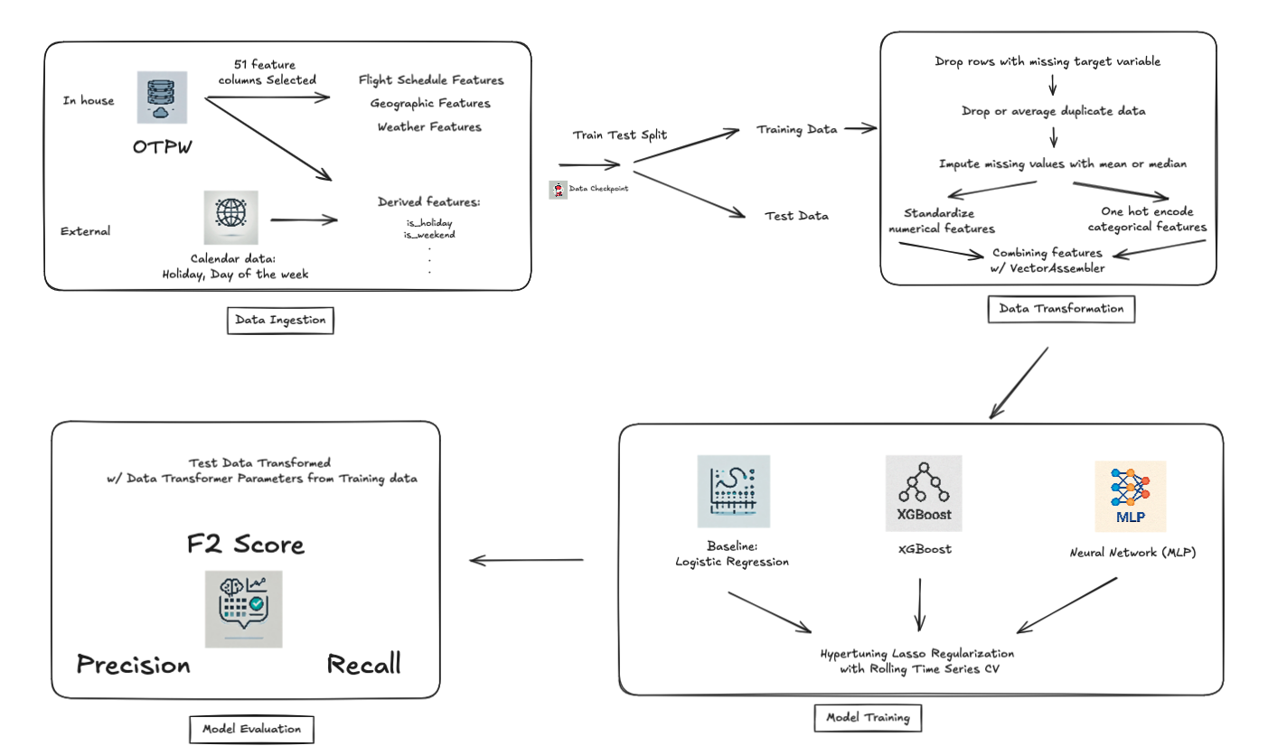
ML Pipeline
Notes:
Licheng -
Talk about taking this transformed data and passing through our modelling pipeline, which is designed to convert features usable by any normal ML Model, and evaluating the results
2 out of 51 is used only for Rolling Time Series CV Split, not for training

Slide 19
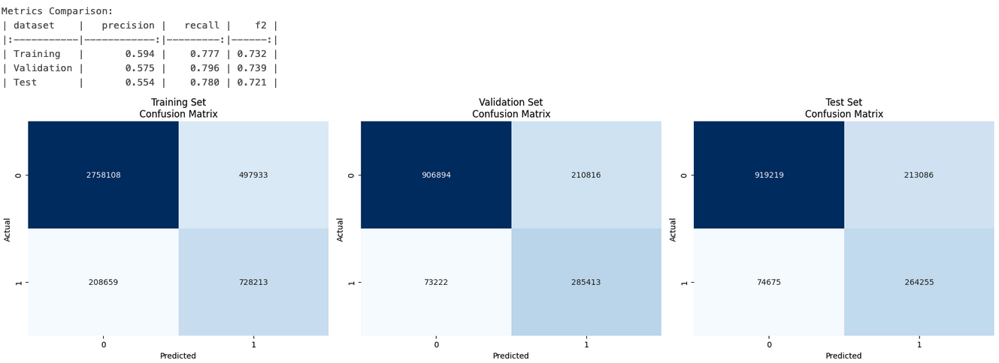
Baseline Results - Logistic Regression 2015-2019
No Regularization; Runtime = 2 minutes, GPU - 5 Workers
Notes:
Licheng HyperTune RegParam of Lasso with Rolling Time Series CV
Talk about the 2 models we used, why they were a good first choice and regularization + Hypertuning implemented on it, dont talk about the results just everything that was experimented on by us, like what logistic regression is and why it works, why is there a need for regularization, what is it ( since our audience is senior leadership, it is important for us to remind them of these thing)

Slide 20
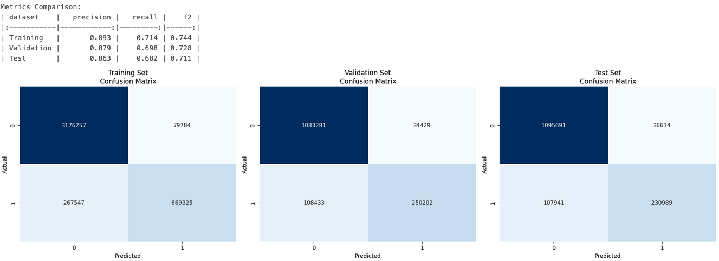
XGBoost Results - 2015-2019
(n_estimators=100, max_depth=6, learning_rate=0.3); Runtime = 3 minutes, GPU - 5 workers
Notes:
Licheng HyperTune RegParam of Lasso with Rolling Time Series CV
Talk about the 2 models we used, why they were a good first choice and regularization + Hypertuning implemented on it, dont talk about the results just everything that was experimented on by us, like what logistic regression is and why it works, why is there a need for regularization, what is it ( since our audience is senior leadership, it is important for us to remind them of these thing)

Slide 21
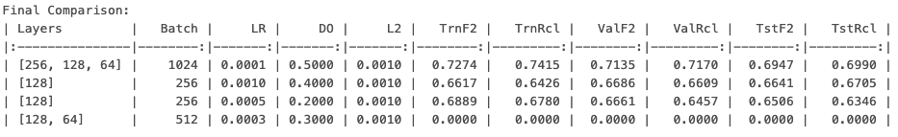
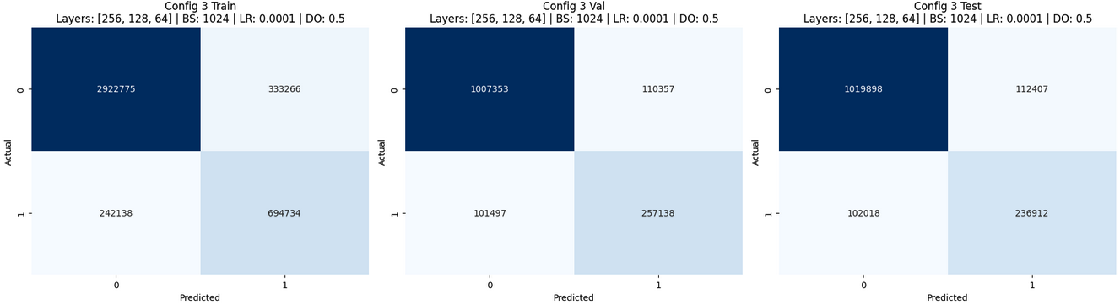
Neural Network Results - 2015-2019
Runtime = 27 minutes, GPU - 5 workers
Notes:
Licheng HyperTune RegParam of Lasso with Rolling Time Series CV
Talk about the 2 models we used, why they were a good first choice and regularization + Hypertuning implemented on it, dont talk about the results just everything that was experimented on by us, like what logistic regression is and why it works, why is there a need for regularization, what is it ( since our audience is senior leadership, it is important for us to remind them of these thing)

Slide 22
Conclusion
Best Model: XGBoost
Comparable F2 (0.73) with Logistic Regression (0.74)
Higher than NN’s 0.66
All metrics are around 0.7 or above
Logistic Regression has a bad precision: 0.57
Number of features: 49
Hyper parameters:
n_estimators=100
max_depth=6
learning_rate=0.3
Notes:
Licheng
What was the final result after all of the above experiments , what do the various metrics like precision and recall mean, state why they were chosen over accuracy

Slide 23
Top 10 features from XGBoost by Gain
prev_cancelled
sw_market_share (by origin airport)
minutes_between_flights
origin_type (large vs medium vs small airport )
day_of_week
dest_type (large vs medium vs small airport )
Prior_day_delay_rate (by origin airport)
time_of_day (morning, midday, evening, night)
Prior_delays_today (by origin airport)
Sw_origin_time_perf (by origin airport and 15 min time bucket)

Slide 24
Questions?

Slide 25
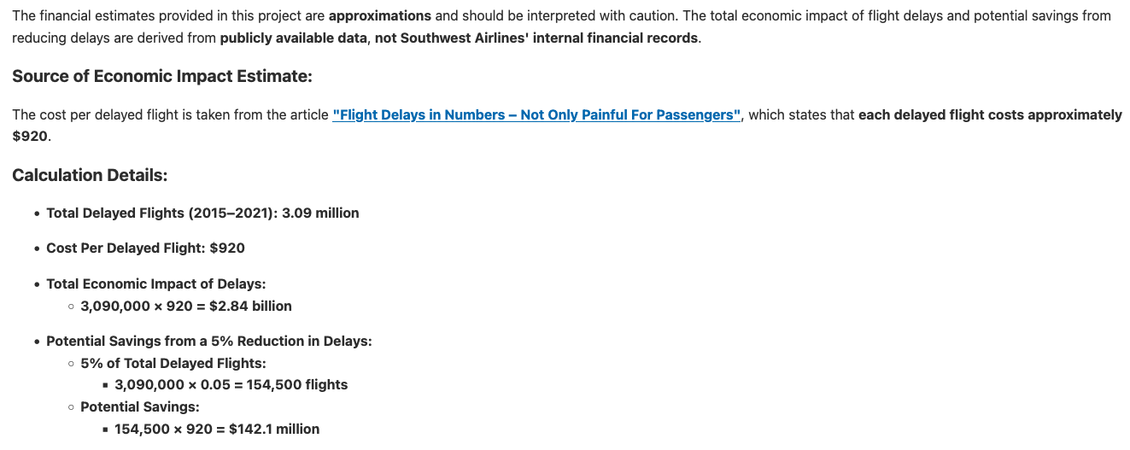
Appendix: Clarification of Financial Calculations

Slide 26
Appendix: Clarification of Financial Calculations
2019 total delay rate: 551, 740
True prediction delay: 236,912
Delay opportunity
236,912 * 920 ~ $218 Million
5% cost reduction
236, 912 * 5% = 11,845.6 * 920 ~ $10.9 Million
10% cost reduction
236, 912 * 10% = 23,691 * 920 ~ $22 Million

Slide 27
Appendix: Operational Costs Breakdown
Sources
1: https://www.sec.gov/ix?doc=/Archives/edgar/data/0000092380/000009238022000007/luv-20211231.htm
2:
https://www.iata.org/en/publications/newsletters/iata-knowledge-hub/unveiling-the-biggest-airline-costs/

Slide 28
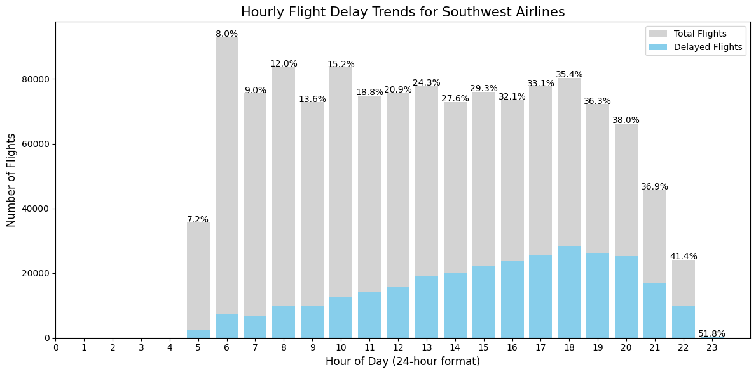
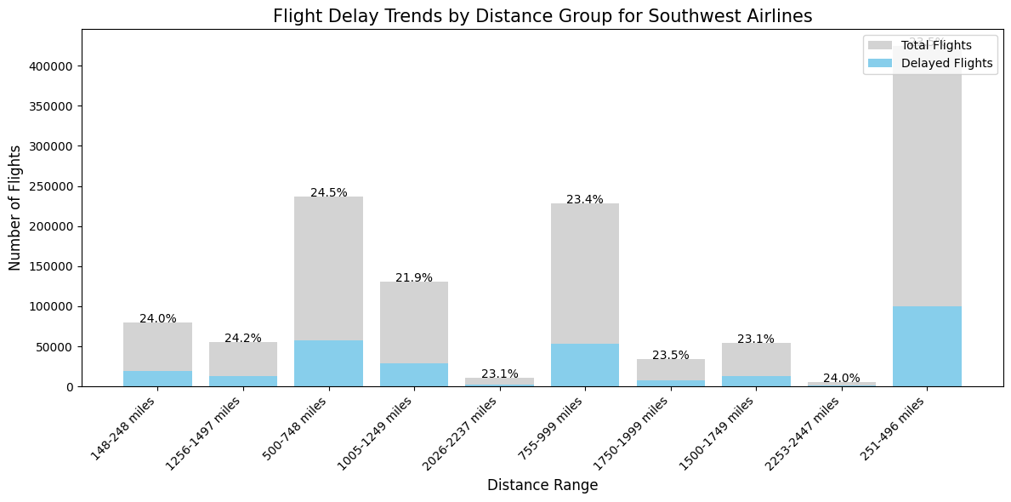
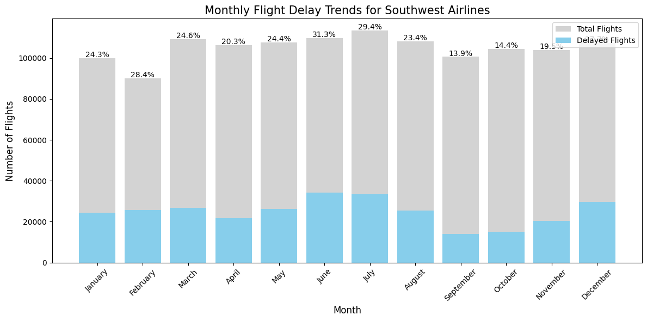
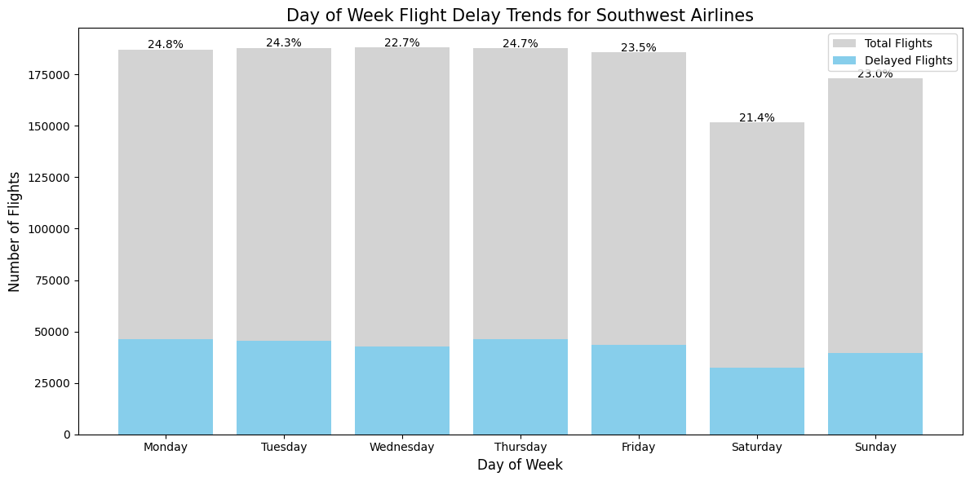
Appendix:

